Slide 1
Focus group discussion: a way to unpack ELT teachers’ conceptions of ELT teacher research
Chan Narith KEUK
PhD student, Department of Linguistics
Principal supervisor: Dr. Stephen Moore
Associate supervisor: Dr. John Knox

Slide 2
Outline
Background
Overview of the literature
Methodology
Findings
Discussion
Conclusion

Slide 3
Background: An overview of ELT teacher research in Cambodia
Broader
ELT
Organizations
(CamTESOL)
ELT
Institutions
Individual English teachers
Micro
Meso
Macro

Slide 4
Background: Cambodian ELT professionals’ participation in research, compared to international presenters (CamTESOL conference series).
Year | Presentations
 | International presenters |  | Cambodian presenters |  | Cambodian + Int. presenters
 | No. | % | No. | % | No. | %
2005 | 35 | 74.4 | 10 | 21.3 | 2 | 4.3
2006 | 77 | 86.5 | 12 | 13.5 | 0 | 0
2007 | 67 | 77.0 | 20 | 23.0 | 0 | 0
2008 | 149 | 84.2 | 27 | 15.3 | 1 | 0.6
2009 | 196 | 92.5 | 15 | 7.1 | 1 | 0.5
2010* | 224 | 92.5 | 15 | 6.2 | 3 | 1.2
2011 | 251 | 92.6 | 19 | 7.0 | 1 | 0.4
2012 | 362 | 95.3 | 18 | 4.7 | 0 | 0
2013 | 464 | 93.5 | 30 | 6.0 | 2 | 0.4
2014 | 488 | 93.4 | 27 | 5.2 | 7 | 1.3

Slide 5
Background: papers published in the CamTESOL Selected Papers Proceedings and LEiA Journal
Year | Papers published
 | International authored papers |  | Cambodian authored papers |  | Total
 | No. | % | No. | % | No. | %
2005 | 3 | 75 | 1 | 25 | 4 | 100
2006 | 2 | 50 | 1+1* | 50 | 4 | 100
2007 | 5 | 83.3 | 1 | 16.7 | 6 | 100
2008 | 10 | 76.9 | 3 | 23.1 | 13 | 100
2009 | 25 | 96.2 | 1 | 3.8 | 26 | 100
2010 | 18 | 90 | 2 | 10 | 20 | 100
2011(1) | 12 | 100 | 0 | 0 | 12 | 100
2011(2) | 8 | 100 | 0 | 0 | 8 | 100
2012 (1) | 9 | 100 | 0 | 0 | 9 | 100
2012 (2) | 12 | 92.3 | 1* | 7.7 | 13 | 100
2013 (1) | 6 | 100 | 0 | 0 | 6 | 100
2013 (2) | 7 | 100 | 0 | 0 | 7 | 100

Slide 6
Review of the literature
1) Current “teacher research” in language teaching
Research on “language teacher research” have been undertaken worldwide:
Language Teacher Research Series (Series Editor Thomas S. C. Farrell) published Language teacher research in Australia and New Zealand, Asia, the Americas, Africa, and the Middle East.

Slide 7
Review of the literature (Cont.)
Recently, more studies on “language teacher research” have been conducted in
- China (Barkhuizen, 2009; Barkhuizen & Gao, 2010; Gao, Barkhuizen, & Chow, 2011; Borg & Liu, 2013),
- Cambodia (Moore 2011a, 2011b; Keuk, 2014),
- Vietnam (Hiep, 2006)

Slide 8
Review of the literature
2) Current ELT teacher research in Cambodia
Moore (2011a): ELT teacher research in Cambodia can be viewed through two perspectives:
a. insiders’ view: ELT teacher research is seen as an organic growth.
b. non-Cambodian outsiders’ view: ELT teacher research is seen as ‘a case of intentional and targeted deficit filling’ (p.335)

Slide 9
Review of the literature (Cont.)
3) Teachers’ conceptions of teacher research in language teaching:
Moore (2011b) and Borg (2009) - commonly identified features of good research in language teaching:
large samples, variables, hypothesis, objectivity, statistics, generalizability

Slide 10
Review of the literature (Cont.)
Borg (2009, p.377)
“Teachers may have inappropriate or unrealistic notions of the kind of inquiry teacher research involves.”
Borg (2013, p. 70)
“Understanding the conceptions of research held by teachers is important in attempts to engage them with and in research.”

Slide 11
Review of the literature (Cont.)
4) Focus group discussion
What is focus group?
“Focus groups are a research method based on open-ended group discussions that examine a particular set of socially relevant issues.” (Marková et al., 2007, p. 32)

Slide 12
Review of the literature (Cont.)
Why focus group discussion?
“A focus group interview is for an in-depth exploration of a topic about which little is known.” (Stewart et al., 2007)
“The purpose of using focus group is to collect rich, detailed data.” (Carey & Asbury, 2012)

Slide 13
Aim of presentation
The aim of this presentation is two-folded:
to share the findings of Phase 1 of my PhD thesis, “Cambodian ELT professionals’ conceptions of ELT teacher research” from a macro perspective; and
discuss how a focus group, a tool used to collect data, can contribute to rich and detailed data, which allowed in-depth analysis.

Slide 14
Methodology
Phase 1: Macro views of ELT research
In this phase, I adopted an interpretive paradigm using a focus group discussion (and two supplementary individual interviews).
Research instrument | Duration | No. of participants | Pseudonym | Age | Occupation
Focus Group | 2hrs 24mins | 4 | K1, K2, K3, K4 | 20s=1 30s=3 | University ELT professionals
Individual interview | 60mins | 2 | K5, K6 | 30s=1 40s=1

Slide 15
Methodology (Cont.)
The focus group was divided into five parts:
Part | Task | Description
1 | 1 | The participants reported their research background.
2 | 1 | The participants defined ‘teacher research’ with their own opinions.
 | 2 | The participants discussed 10 pairs of ‘research scenarios,’ adapted from Borg’s (2009) baseline scenarios.
 | 3 | The participants considered one of five published definitions of teacher research.
3 | 1 | The participants shared their beliefs about the current ELT teacher research.
4 | 1 | The participants discussed their conceptions of communities of practice of ELT teacher researchers in Cambodia.
5 | 1 | The participants discussed their future plan for participating in doing research.

Slide 16
Methodology (Cont.)
Data analysis
The data were transcribed using Nvivo software.
The analysis of the focus group data followed Marková et al.’s (2007) analytical approaches – focus group as dialogism.
“the focus group method provides rich material, but the way in which focus group data are analysed (if analysed at all) often reduced this richness to a list of contents which participants have discussed.” (Marková et al., 2007, p. 51)

Slide 17
Data analysis
Thus, this analysis will examine (1) what is said; (2) how it is said; (3) for whom it is said; and (4) in which communicative activity types. This way of analysis will achieve a triangulation of data analysis.

Slide 18
Analysis: communicative activity types
1) Focus group task
The participants discussed 10 pairs of research scenarios, each of which has two sets, i.e. set ‘a’ and set ‘b’. Set ‘a’ scenarios were Borg’s (2009) research scenarios, and Set ‘b’ scenarios were contextualised and adapted with some different features from those in set ‘a’ to allow the participants to discuss in order to decide whether or not each scenario is research.

Slide 19
Analysis: communicative activity types (Cont.)
The participants were asked to provide their own opinions about the research scenarios in turn to avoid overlapping in recording, and they were required to mention their pseudonyms before sharing their opinions.
However, the task did not explicitly state that they should come up with a shared decision.

Slide 20
Analysis: communicative activity types (Cont.)
The scenarios were adapted on the basis of some of characteristics of Borg’s (2010) basic definition of teacher research in language teacher.
The scenarios were contextualised basing on the local context; that is, the contextualisation was based on the context of Institute of Foreign Languages (IFL), from which three of four participants graduated BEd (TEFL) and two of these three graduated MA (TESOL).

Slide 21
Analysis: communicative activity types (Cont.)
Borg (2010): basic definition of teacher research–
A systematic inquiry (quantitative/qualitative),
being conducted by teachers (individually/ collaboratively) in teachers’ own contexts,
to enhance teachers’ understanding about their practice and perhaps to inform this practice to institutional and other beyond-classroom bodies, and
being made public. (p. 395)

Slide 22
Analysis: communicative activity types (Cont.)
An example of a pair of research scenarios.
Scenario 1a “A teacher noticed that an activity she used in class did not work well. She thought about this after the lesson and made some notes in her diary. She tried something different in her next lesson. This time the activity was more successful.”
Scenario 1b “A teacher at IFL noticed that an activity she used in class did not work well. She thought about this after the lesson and made some notes in her diary. She discussed these notes with her colleagues and learned new teaching techniques. She tried these new techniques in her next lesson. This time the activity was more successful. She practiced it in several lessons and realized that it worked effectively. She started to write up a paper to publish in a local ELT journal.” (See some more examples in the handouts)

Slide 23
Analysis: communicative activity types (Cont.)
2) Participants
The participants were all ELT lecturers at different tertiary ELT institutions (universities) in Phnom Penh.
All participants hold Master degrees from either overseas or domestic universities.
Three of them were former IFL graduates, two of whom were classmates in the IFL’s MA (TESOL) program. They know the moderator/researcher.

Slide 24
Analysis: communicative activity types (Cont.)
Recruitment of participants
-The recruitment was based on recommendation of the head of the English department of each selected ELT institution, i.e. three participants were recommended from each institution.
-Then an EoI letter was sent to the first participants, and when they agreed to participate in the FG, an Information and Consent form was sent to them.

Slide 25
Analysis: communicative activity types (Cont.)
3) Task duration
The discussion took around one hour, including a period of time for reading the scenarios, so the discussion of each pair of the scenarios took around 10 minutes.
4) Task material
A printed text comprising ten pairs of the research scenarios was given to the participants.

Slide 26
Analysis: communicative activity types (Cont.)
5) Task sequence
The FGD presented here is part of a larger FGD. The participants were given the overall purposes of the large FGD and, specifically, the purpose of this (part) FGD.
In the introduction of the whole FGD, two important terms, “engagement with (reading) research” and “engagement in (doing) research” (Borg, 2010) were explained to the participants.

Slide 27
Analysis: communicative activity types (Cont.)
In this (part) FGD, after the moderator’s instruction, the participants were allowed around 15 minutes to scan through the scenarios.
Then each scenario of the pair was discussed in turn. Any participant could begin the discussion, but the moderator sometimes invited the quiet participants to give their opinions to balance the discussion/ sharing opportunities.

Slide 28
Analysis: communicative activity types (Cont.)
6) Participants’ social roles
The participants, especially K1, strongly perceived their role as ELT professionals. As seen in excerpt 1 of K1’s explanation of scenarios 1a, K1 clearly spelled out this role as ELT lecturers, and what they should do, i.e. observing and reflecting their own teaching, and making their own decision to improve their teaching, as reflected through his use of ‘we’, referring to the participants themselves, distinguished from ‘she’, referring to the teacher mentioned in the scenario.

Slide 29
Analysis: communicative activity types (Cont.)
Later, this role as ELT lecturers was transformed to a role as ELT teacher researcher when K1 discussed scenario 1b. This new role was perceived to have related with another role of a third party, which is also involved in the topic being discussed; that is, a role as an ELT journal manager, evaluating the quality of the draft paper of a research project for publication.

Slide 30
Analysis: communicative activity types (Cont.)
Excerpt 1
“ok I'm K1. I want to share a little bit about er (.7) scenario 1 (.) a and b. (.8) 1a like previous er er K1 (.) ((addressing himself)) K2, K3 and K4 said (.) it's about our own observation (.) ((clearing his throat)) our own (.) I mean reflection in the classroom we reflect what (1.1) what we should improve (.) and then we do our own er i mean (1) i mean decision [(.)] and then for "b" we (.) we have to discuss with (.) er (M:hmhm) other colleagues so we have more samples we have more (.) i mean broader solutions (.) for not only for a class maybe for (.) the whole school (.) and that's why she can come up with er (.) a paper to the ELT journal (.) and then they will discuss more I think maybe the (.) the ELT journal er manager or he can check (.) and then follow up later [(.)] so it becomes a fully research full research (.)” (K1, 1a -1b, Lines 90-102)

Slide 31
Analysis: communicative activity types (Cont.)
Excerpt 2-Participants brought in their experiences
“I’m K1 (.) I want to share about er scenario (.) 3a and b (.9) er from my experience (.) 3a is also research (.8) we call this er library research because we do most of the work (.) I mean reading a lot in the (.) documents in the library only they don’t need to go to the field (.) they do in the library (.) and they can come up with their own findings or yes summary yes (.7) I think that that the main focus we have the finding (.8) from the library (.) he read many books and then he come up (.) with his own assumption (.) or own finding that’s (.) about the research (.7) but in the library only (1) he did not have interview observation and so on (1) like previous (.) like (.) 1a 1b we have we have we observation in a classroom (.) in Cambodian context I think even observation we also call research but I think sometimes it’s not really a research and for 3b I support it’s real it’s a real research (.8) 3b (.) thank you ” (K1, 3a, 3b, Lines 228-244)

Slide 32
Analysis: communicative activity types (Cont.)
Excerpt 3 – Participants brought in their preferences
“I I may ((giggling and laughing)) er K2. I think so. I think (.) yes scene (.) scenario er 2a (.) and 2b are similar to er (.7) er scenario 1a and 1b (.8) yes er (.8) er scenario 2b is more [(1.3)] a research [(.)] Yes, more but but I'm not saying that er (.) 2a is not a research it’s [also a research too] er (2.1) and I like 2b because er I look at the experiment you know his experiment is to compare (.8) er (.) the the learners' written work produced er (.) before and after [(1.6)] and compare comparison [(.)] this is what I like.” (K2, 2a, 2b, Lines 136-146)

Slide 33
Analysis: communicative activity types (Cont.)
7) Activity role
In this FGD, the participants appeared to have played a role as formal group discussants who shared their opinions about each research scenario. Ex.
“ok let me start first again (.) I am 4K (.8)” (K4, !a, 1b, Line 28)
“ok I'm K1. I want to share a little bit about er (.7) scenario 1 (.) a and (K1, 1,a, 1b, Line 90)
They also played a role as analysts, i.e. they analysed the research scenarios.

Slide 34
Analysis: communicative activity types (Cont.)
This role was later developed to a more debater-like role when the participants were defining some relevant terms such as ‘report’, ‘paper’, and esp. ‘teacher research’. (See their discussions of scenarios 5a, 5b, 6a, 6b, 7a, 7b, 8a, 8b)
“I’m K4 (.7) I think if we (.) we look at the term research so (.) they (.)…” (K4, 6a, 6b, Line 411)
“just wanna share with with er (.) the word (.) especially I find some find confusing about the word (.) … be submitted to an educational journal ((K3 laughing))…” (K1, 7a, 7b, Lines 510-512)
“that’s why I say 7b is not really a research ((laughing))” (K4, 7a, 7b, Line 536)

Slide 35
Analysis: communicative activity types (Cont.)
8) Interactional and referential analysis
The participants did not only interact with the moderator, but also with other FGD members.
In their discussions, they referred to each other’s discourses and to their previous discourses.
“er I am K4 er I I agree with K2 they are both researches just er they …” (K4, 5a, 5b, Line 373)
“(.8) er like we have talked previously about er teacher research like K4 said right (.) (yes ((soft voice; unidentified speaker))) our own research for our classroom to improve our teaching materials or (.)” (K1, 8a, 8b, Lines 561-563)

Slide 36
Analysis: communicative activity types (Cont.)
9) Moderator’s role
The moderator was also a researcher. He was also a former lecturers of the participants who graduated from IFL.
In this FGD, the moderator stated the overall aim of the FGD and the aim of this (part) FGD. He provided instructions, as well as reminded the participants there were no right or wrong definitions of ‘research’. He also provided back channels and when a participant’s opinions could not justify whether or not the scenario was research, he clarified the participant’s decision.
He also balanced the participants’ talking turns.

Slide 37
Analysis: communicative activity types (Cont.)
Summary: My analysis has so far revealed:
This FGD is not a focus group interview; it’s an interactional discussion as dialogism (Marková et al., 2007)
The participants framed their discussions, i.e. discussion framings/positionings/participation frameworks (Marková et al., 2007) in ways that they were ELT professionals, showing their responsibilities for their own teaching and students’ learning; group discussants, providing opinions and explaining about the research scenarios and reasoning their decisions; debaters, defining relevant terms and arguing for their own opinions by referring to others’ discourses and their previous discourses.

Slide 38
Analysis: communicative activity types (Cont.)
3) We can see that the participants brought into the discussion of the different research scenarios their personal preferences, experiences, and knowledge, which formed their socially shared knowledge of the topic being discussed; that is, the knowledge of English language teaching and research. They did not only talked to each other in the group but also referred to other external bodies, i.e. ELT journal managers and journal readers, etc.

Slide 39
Analysis: content (what is said?)
Participants’ opinions about scenario 1a
Quantitative
Not Teacher
Research research Research
K1 K3 K4 K2
Qualitative
1a: A teacher noticed that an activity she used in class did not work well. She thought about this after the lesson and made some notes in her diary. She tried something different in her next lesson. This time the activity was more successful.
1a
1a
1a

Slide 40
Analysis: content (Cont.)
Participants’ opinions about scenario 1b
Not
Research Research
K1 K2
K4 K3
Scenario 1b: A teacher at IFL noticed that an activity she used in class did not work well. She thought about this after the lesson and made some notes in her diary. She discussed these notes with her colleagues and learned new teaching techniques. She tried these new techniques in her next lesson. This time the activity was more successful. She practiced it in several lessons and realized that it worked effectively. She started to write up a paper to publish in a local ELT journal.
Quantitative
1b
Qualitative

Slide 41
Analysis: content (Cont.)
Participants’ opinions about scenario 8a
K3 K2
K1 K4
Not Teacher
Research research Research
Scenario 8a: Mid-way through a course, a teacher gave a class of 30 students a feedback form. The next day, five students handed in their completed forms. The teacher read these and used the information to decide what to do in the second part of the course.
Quantitative
8a
8a
Qualitative

Slide 42
Analysis: content (Cont.)
Participants’ opinions about scenario 8b
Not Teacher
Research research Research
K3
K1 K2
K4
Scenario 8b: Mid-way through a course, a teacher at IFL spent half an hour talking with his students in order to elicit some feedback on her teaching. He noted what the students shared and used the information to decide what to do in the second part of the course.
Quantitative
8b
8b
Qualitative

Slide 43
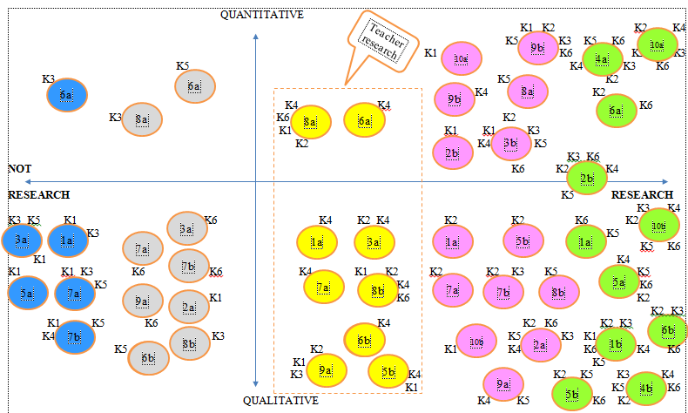
Analysis: content (Cont.) Participants’ opinions about the research scenarios
Borg’s (2010) definition of TR

Slide 44
Findings
The participants distinguished ‘teacher research’ from ‘research’
 | ELT teacher research | Research
Who? | Research is conducted by teachers. | Research is not necessarily conducted by teachers.
In what context? | Classroom context | Classroom context and outside classroom context
What research paradigm? | More likely following qualitative research paradigm. | More likely following quantitative research paradigm
Systematic? | Less systematic. | More systematic.
Sharing? | Not necessarily sharing, but if sharing happens, oral sharing with colleagues is stated. | Presented at any conference or written publication in any journal.
Scale? | A narrow scope. | A large scope.
What purpose? | To improve teaching and learning within the classroom. | Expanding purposes to outside the classrooms.
What is it related to? | Classroom observation, reflection action research, classroom research | Anything – unconstrained

Slide 45
Discussion
The participants’ conceptions of ELT teacher research show that teacher research in the Cambodian ELT context is confined to an informal action (self-reflection, observation) undertaken by teachers for teaching improvement. ‘Teacher research’ was distinguished from ‘research’. Their conceptions of ‘ELT teacher research’ lagged behind what Freeman (1998) and Borg (2010) suggest that teacher research should be made public.

Slide 46
Discussion (Cont.)
2) In this FGD, some of Borg’s (2009) research scenarios were only viewed as ‘teacher research’ (see Table 1, scenarios 1a, 3a, 7a, 8a, and 9a).
3) Some scenarios were likely to be viewed as ‘not research’ in Borg’s (2009) survey but were likely to be viewed as ‘teacher research’ in the current study (see Table 2, scenarios 8a and 9a) .
4) Some scenarios were likely to be viewed as ‘teacher research’ in the current study but were likely to be viewed as ‘research’ in Moore (2011b) (see Table 2, scenarios 8a and 9a).

Slide 47
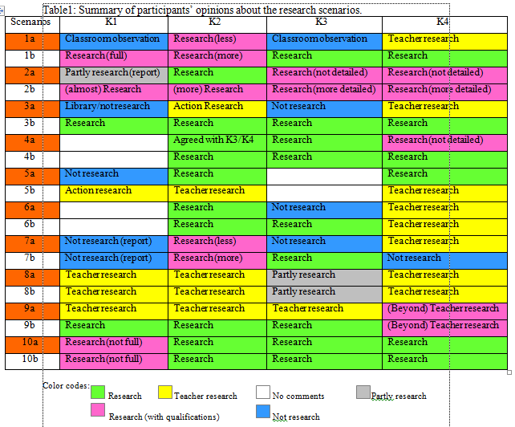
Discussion (Cont.)

Slide 48
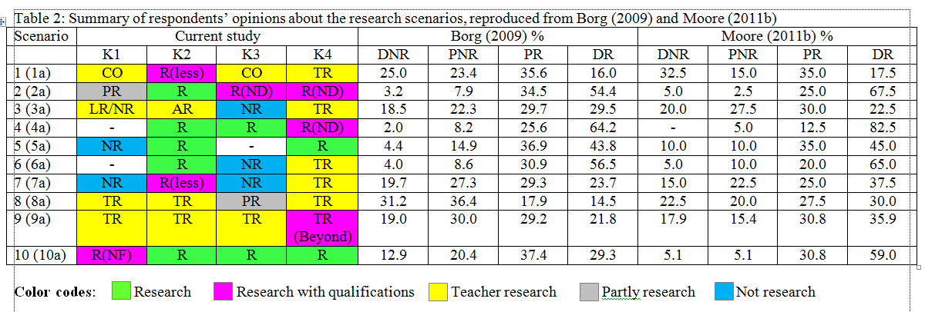
Discussion (Cont.) Table 2: Participants’ opinions compared with the respondents’ perceptions in Borg’s (2009) and Moore’s (2011b) surveys

Slide 49
Discussion (Cont.)
5) In the current FGD study, at least six times the participants identified the scenarios as ‘research’ but attached to them with some qualifications (see Table 1, scenarios 1a, 2a, 4a, 7a, 9a and 10a).

Slide 50
Discussion (Cont.)
An examination of these research scenarios reveals that they do not comprise a full description of a research process, i.e. covering from planning a research project; taking actions such as selecting samples, collecting data, analysing data, an interpreting the findings; and making the research public. The participants, to most extent, did not infer the scenarios covering a complete research process. If the aim is to clearly understand teachers’ conceptions of research through their responses/ opinions about these scenarios, these scenarios need revision.

Slide 51
Discussion (Cont.)
This (part) FGD has provided supplementary data of ELT professionals’ conceptions of (ELT) teacher research which have been informed in the previous studies (Borg, 2009; Moore, 2011b). Following Marková et al.’s analytical approaches, focus group as dialogism, to analyse these FGD data does not only help us examine the participants’ conceptions of teacher research in terms of what they said but also how they said it and in what communicative activity types. It helps us triangulate our analysis of the FGD data.

Slide 52
Conclusion
The participants had different views of ‘ELT teacher research’ at the beginning of the discussion of the different scenarios, but as the discussion developed, they had clearer conceptions of ‘ELT teacher research’ , which is distinguished from ‘research’.
Therefore, a clear and widely accepted definition of ELT teacher research would be helpful to conceptualise ELT teacher research in Cambodia if the aim of tertiary ELT institutions is to promote Cambodian English teachers’ active engagement in undertaking research.

Slide 53
Thank you!
Questions or comments?
Contact: chan-narith.keuk@students.mq.edu.au

Slide 54
Some useful references
Borg, S. (2009). English Language Teachers' Conceptions of Research. Applied Linguistics, 30(3), 358-388.
Borg, S. (2010). Language teacher research engagement Language Teaching, 43(4), 391-429.
Borg, S., & Liu, Y. (2013). Chinese College English Teachers' Research Engagement. TESOL Quarterly, 47(2), 270-299.
Carey, M. A., & Asbury, J.-E. (2012). Focus group research. California: Left Coast Press.
Freeman, D. (1998). Doing teacher research: from inquiry to understanding Toronto: Heinle & Heinle Publishers.
Gao, X., Barkhuizen, G., & Chow, A. W. K. (2011). Research engagement and educational decentralisation: problematising primary school English teachers’ research experiences in China. Educational Studies, 37(2), 207-219.
Marková, I., Linell, P., Grossen, M., & Orvig, A. S. (2007). Dialogue in focus groups: exploring socially shared knowledge. London: equinox.
Moore, S. (2011a). The Struggle to Develop a "Research Culture" in a Developing Country. TESOL Quarterly 45(2), 334-343.
Moore, S. (2011b). Cambodian English teachers' conceptions of and engagement with research. Selected Proceedings of the International Conference: Doing Research in Applied Linguistics (pp. 83-98). Bangkok: School of Liberal Arts, King Mungkut's University of Technology Thonburi.
Stewart, D. W., Shamdasani, P. N., & Rook, D. W. (2007). Focus Groups: Theory and Practice (Vol. 20). Thousand Oaks: SAGE.

